Slide 1

CourseCraft
Submitted to:
Submitted by:
Kartikya Sokhal- 2410990513
Tanishq Chhabra - 2410990563
Piyush Garg - 2410995
Neha Prashar - 2410990538

Slide 2
INTRODUCTION
Education and skill development have become crucial in today’s fast-growing world. Students and professionals constantly look for platforms where they can learn efficiently without wasting time or money. However, most online learning platforms either lack personalization, are too costly, or do not provide structured learning paths.
To overcome this problem, we are developing CourseCraft – an AI-powered course creation platform that allows users to generate complete, customized courses within minutes. With just a topic input, the system creates a structured learning path that includes lessons, resources, and assessments. This makes learning faster, more accessible, and more engaging.
CourseCraft is designed to be scalable, reusable, and adaptable for future needs. It reduces the time and effort required to build or access courses, ensuring that learners focus on actual knowledge building rather than searching for the right material.
By integrating Artificial Intelligence with modern web technologies, our platform will not only enhance learning efficiency but also democratize education by making high-quality courses available to everyone.

Slide 3
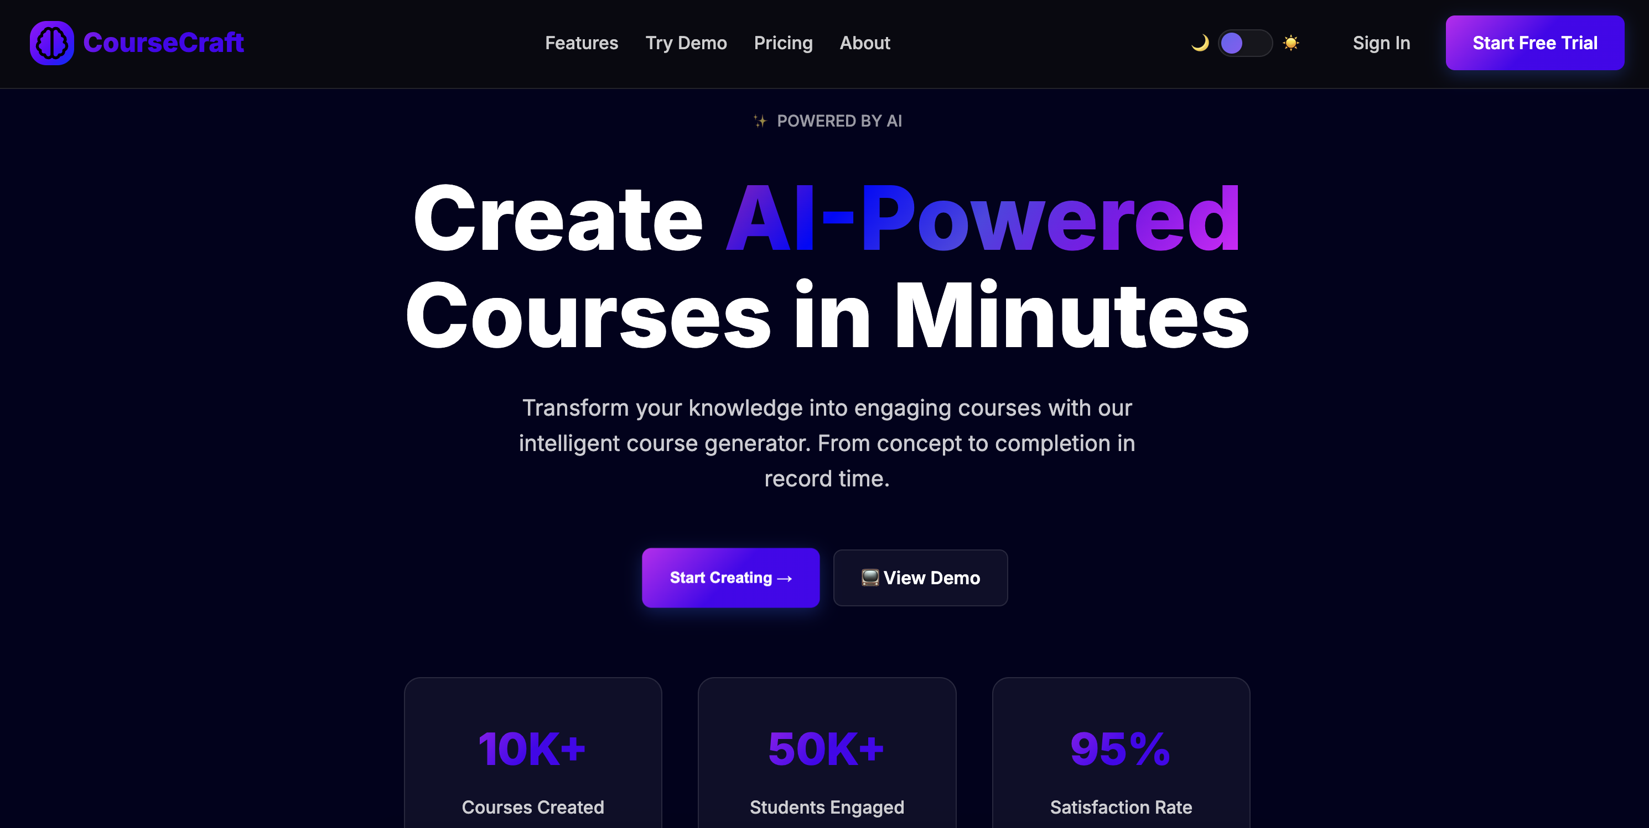
HOME PAGE
CourseCraft provides a clean and user-friendly homepage where users can easily explore the platform’s features.

Slide 4
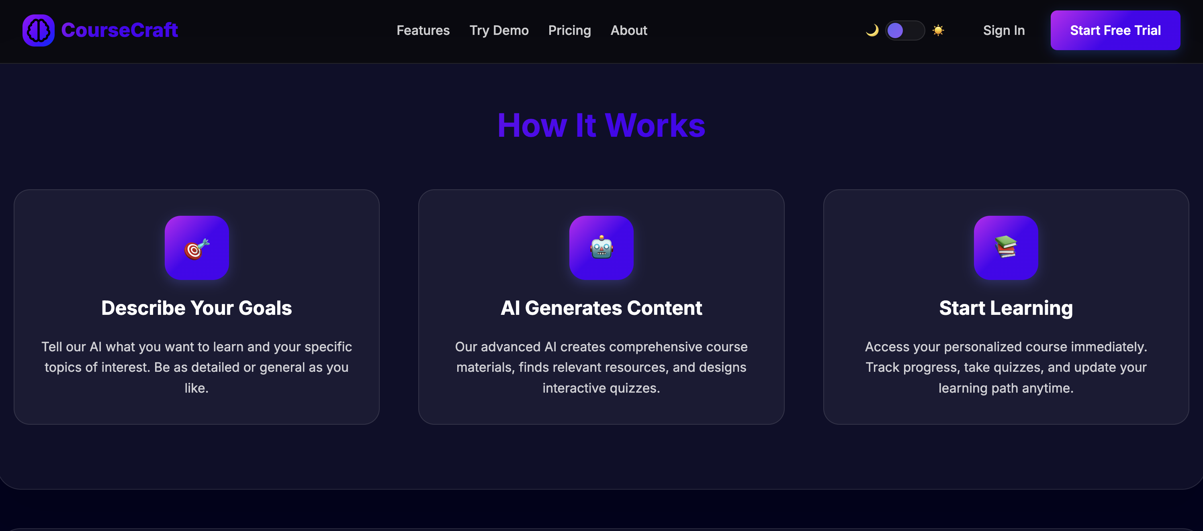
FEATURES
CourseCraft makes learning simple – just share your goals, our AI generates a complete course, and you can start personalized learning instantly.

Slide 5
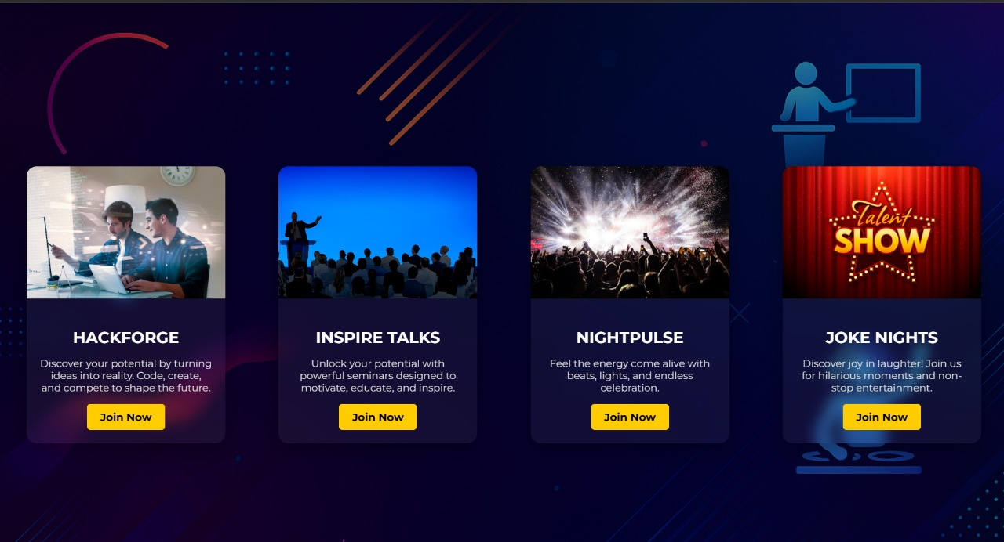
EVENTS PAGE
Our platform brings various kind events together in one place.Which makes it easier for student to check all the events in one place and also can decide which event is suitable for them

Slide 6
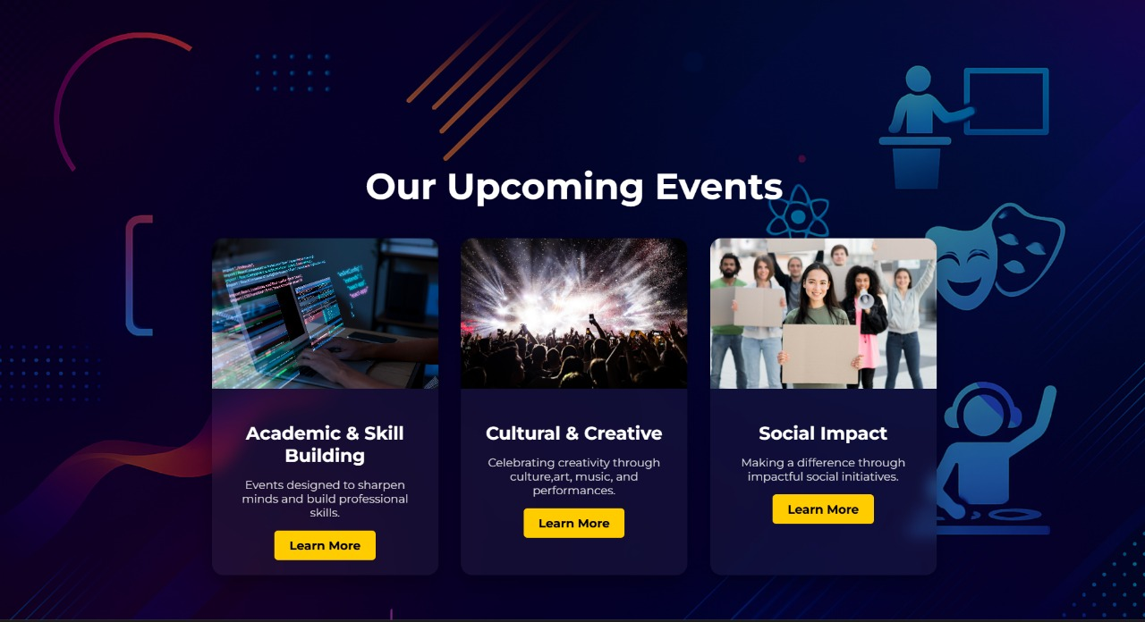

Slide 7
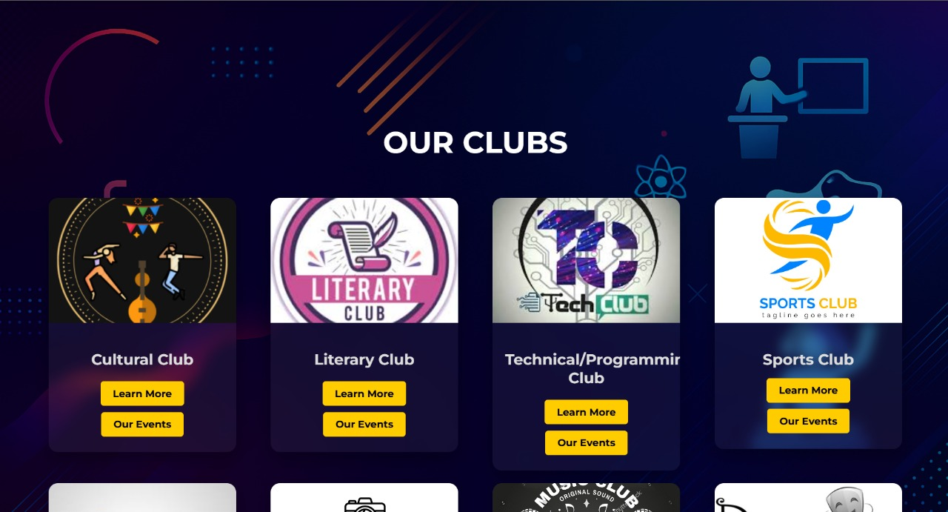
CLUBS PAGE
Our website connects students through different clubs that match their interests and can register for the events of that particular club.

Slide 8
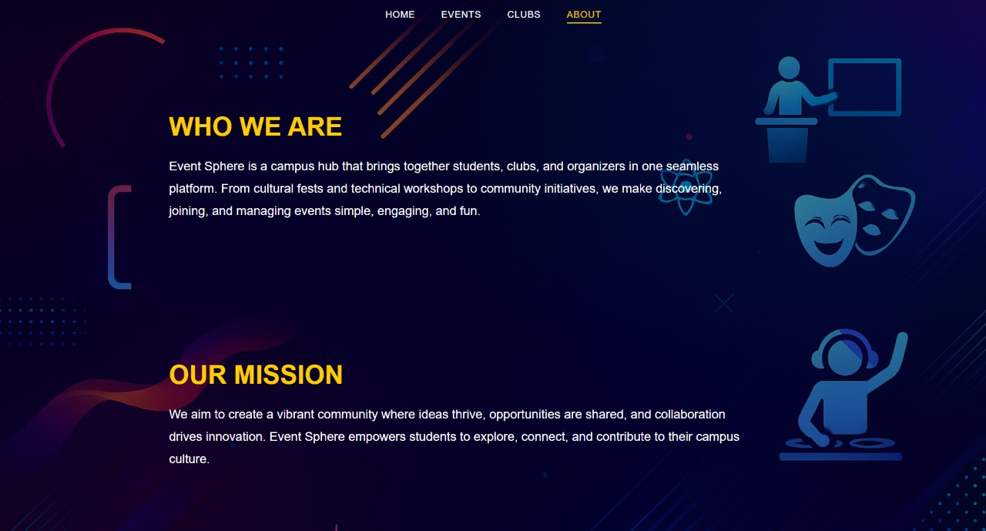
ABOUT US
We bring students, clubs, and organizers together on one platform to manage events simple and fun. Our aim is to build a friendly community where everyone can get knowledge about the event.

Slide 9


